Slide 1
NAHRO Washington Update Jonathan Zimmerman Senior Policy Advisor

Slide 2
Housing Assistance Payment and Ongoing Administrative Fee Pro-Rations & Voucher Lease-up Rates

Slide 3
Iron Triangle / Triple Constraint
Both pro-rations for administrative fees and Housing Assistance Payments in FY 2013 as appropriated by Congress, are the lowest in the 38 year history of Section 8 voucher programs. Downward pro-rations in HAP adversely impacts PHAs’ ongoing administrative fee revenues and downward pro-rations in PHAs’ ongoing administrative fees adversely impacts their ability to serve low-income households and participating property owners.
Over the past decade, PHAs have received on average approximately 87 percent of their annual ongoing administrative fee funding from Congress and HUD each year. As a result of dramatic funding reductions, many PHAs are in a very difficult position of having to limit and reduce their program service and performance. The cost, scope, time and schedule requirements necessitated by existing voucher program regulations and HUD assessment systems have inherent competing constraints that impacts quality.

Slide 4
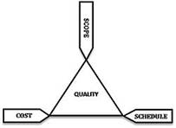
Iron Triangle / Triple Constraint
The project management triangle (also called the Triple Constraint or the Iron Triangle) is universal to all industries and sectors, including in a government measurement and program oversight context.
Over the years, senior HUD PIH officials presented this triangle and the governing concepts to NAHRO members during their presentations at our annual legislative conferences. It is incumbent upon HUD not to micromanage local operations and impede PHAs’ mission to serve low-income households to the greatest of their abilities with the funding provided. Instead, HUD should move quickly to limit risk and measure key program outcomes in a way that harmonizes the inherent limitations in cost, scope, time and schedule requirements.

Slide 5
“Making Difficult Tradeoffs”
On May 30, 2006, the Government Accountability Office (GAO) released a report, Policy Decisions and Market Factors Explain Changes in the Costs of the Section 8 Programs ' (GAO-06-405), that clearly illustrates the tradeoffs in funding policies considered by Congress. The report states “The cost of providing rental assistance has been a long-standing issue for policymakers and has led Congress, on different occasions, to reform various housing programs… To the extent that policymakers wish to stem the rising cost of the voucher program, our analysis suggests that future increases could be mitigated by reducing the number of assisted households, lowering payment standards, requiring households to pay a larger share of their incomes toward rent, subsidizing households with higher incomes, or a combination thereof. However, these actions require making difficult trade-offs between limiting program costs and achieving long-standing policy objectives, such as serving more needy households, having assisted households pay a relatively small share of their incomes in rents, making it easier for voucher holders to find housing (especially in tight rental markets), reducing the concentration of poverty, and giving PHAs the flexibility to respond to local rental market conditions.”

Slide 6
“Making Difficult Tradeoffs”
GAO’s report goes on to note that, while both “Congress and HUD have already responded to the increasing cost of vouchers by changing the way the program is funded. Specifically, HUD no longer provides funding to PHAs based on the number of authorized vouchers, but rather based on the prior year's level of voucher expenditures, adjusted by an inflation factor. While this approach allows HUD to limit the annual rate of increase in the program's cost, [but] it does not directly address the policy decisions and market factors that we identified as contributing to the increase in program costs. Instead, it will be up to PHAs to exercise their flexibilities and make decisions regarding how to use the voucher funding that they receive from HUD.” It then goes on to provide examples of ways that PHAs can limit the growth in voucher costs, “For example, some PHAs may choose to reduce their local payment standard, a course that, as our analysis suggests, would likely limit growth in voucher costs. The decisions that PHAs make will eventually influence trends in outlays, per household subsidies, and unit rents, and these trends will become more apparent in the years following the period covered by our analysis.”

Slide 7
Section 8 Appropriations
 | FY 2013 | FY 2014
Program ($ Millions) | Enacted | Proposed | House | Senate | NAHRO
Tenant-Based Rental Assistance | $17,964 | $19,989 | $18,611 | $19,592
Section 8 HAP Renewals | [$16,349] | [$17,968] | [$17,000] | [$17,568] | $18,540
Ongoing Administrative Fees | [$1,258] | [$1,635] | [$1,335] | [$1,670] | $1,994
Additional Administrative Fees | [$48] | [$50] | [$15] | [$15] | $50
Tenant Protection Vouchers | [$71] | [$150] | [$75] | [$150] | $150
Incremental HUD-VASH Vouchers | [$75] | [$75] | [$75] | [$78] | $75
FSS Coordinators | [$57] | $75 | $60 | $75 | $87
Sec. 8 PBRA | $8,8521 | $10,272 | $9,451 | $10,772 | Fully Fund

Slide 8
6 Percent Cut in Housing Assistance Payments Renewals in FY 2013
many PHAs have had to lease fewer low-income households including rescinding vouchers from those in the housing search process and not being able to lease “turnover” vouchers; resulting in a national voucher lease-up rate of 93 percent in 2012 to as low as 86 percent by 12/31/13;
Annual per voucher costs per household are substantially less than annual shelter cost per household
greater numbers of voucher-assisted households have experienced higher income to housing cost burdens (income to rent and utility allowances or expenses); and
increase waiting times for eligible unassisted households on their waiting lists.

Slide 9
6 Percent Cut in Housing Assistance Payments Renewals in FY 2013
Anecdotally, we have heard from our PHA members:
that participating property owners have not renewed their existing dwelling leases with voucher-assisted low-income housing-assisted households due to the appropriations risk as well as having all annual rent increase requests frozen for six months, in favor of higher income households in the private market and prospective property owners are choosing not to participate in the Section 8 voucher program for the same reason;
a significant loss of available and affordable housing units to extremely-low-income and very-low-income households that has prevented voucher-assisted households from leasing decent, safe, sanitary and affordable housing units; and
voucher-assisted households living in greater concentrations of poverty and living in dwelling units with relatively lower quality housing stock.

Slide 10
31 Percent Administrative Fee Cut in FY 2013
Since administrative fee earnings for each PHA are based on the number of voucher-assisted households leased, as the total number of low-income households leased in voucher programs has decreased in 2013 it has undermined the maximum number of households PHAs could have otherwise leased with the total HAP-related funds available to them. Under an annual rebenchmarking voucher HAP renewal formula for FY 2014 this will lead to a continuation of the “downward spiral” in FY 2013;
Higher proportional reductions in the average number of voucher program staff, corresponding with higher caseload sizes and HQS inspection volumes per staff, higher turnover of voucher staff, higher errors in eligibility determinations and rent calculations due to not having enough staff to handle the workload, overdue recertifications, and improper payments;
Reduction in the families served who require intensive service coordination including homeless veterans, at-risk youth, and disaster victims. With great anguish, more and more PHAs have had to decline incremental HUD-VASH voucher awards, as a direct result of administrative funding levels that are insufficient to administer this important program.

Slide 11
31 Percent Administrative Fee Cut in FY 2013
PHAs have “handed back” their voucher programs to HUD or transferred them to another PHA.
Continued PHA staff layoffs, furloughs, reduction of work days, and not filling vacated positions have led:
to a corresponding reduction and elimination of activities such as program integrity measures and fraud recovery, discretionary interim income and rent re-examinations and other voucher program functions; and
a reduction in briefings, issuing vouchers, assisting in housing search, conducting HQS inspections and the overall lease-up processes are time and labor intensive.

Slide 12
Ongoing Administrative Fee Pro-Rations

Slide 13
PHAs Handing Back Voucher Programs
Since FY 2003 - the last year that PHAs’ received full administrative funding – 213 PHAs, or 9 percent of all PHAs administering voucher programs, have “handed back” their voucher programs to HUD or transferred them to another PHA. When this happens, there is a loss of the kind of services provided by local PHAs and it adversely affects PHAs’ ability to maintain the number of low-income households leased while fully utilizing the rental housing subsidy funds available.

Slide 14
Number of PHAs That Have Handed Back Their Voucher Program to HUD or Transferred to Another PHA

Slide 15
Household Caseload Size Average Per PHA FTE Voucher Program Staff

Slide 18
A 4.3 to 1 ratio (4.3:1) means that an occurrence in a particular area of the Section 8 Tenant-Based Rental Housing Voucher program is 4.3 times the rate of this type of occurrence, when compared with the Project-Based Section 8 Rental Assistance program.

Slide 19
FY 2014 - Section 8 Tenant-Based Housing Assistance Programs Pro-Rations
Base Voucher Housing Assistance Payment (HAP) Funds:
During the House Appropriation Committee’s mark-up of the bill, Rep. Ed Pastor (D-Ariz.) cautioned his colleagues by saying that the $17 billion funding level for FY 2014, already assumes the reduction of approximately 100,000 fewer voucher-assisted households in calendar 2013 due to cuts under the sequester.
Section 8 Ongoing Administrative Fees:

Slide 20
What’s At Stake between House and Senate FY 2014 THUD Appropriation Bills?
Base Voucher HAP Renewal Formula – “Downward Spiral”
HAP Set-Aside Fund
NAHRO’s Recommended HAP Set-Aside Fund
Adjustments to PHAs’ Base Voucher HAP Renewal Funding and HAP Eligibility Reduction Measures: For both non-MtW and MtW PHAs, both bills adopt HUD’s FY 2014 budget proposes a series of HAP eligibility reduction measures including: 1) broadening the definition of “extremely low-income” to apply to families with incomes that are the higher of 30 percent of area median income or the federal poverty level ($155 million); and 2) determining utility allowances based on the bedroom size of the voucher for which a household qualifies under the PHA subsidy standards regardless of size of unit leased ($50 million)
Impacts on PHAs’ HAP Funding as it relates to elderly and disabled households income to rent and utility burdens

Slide 21
Senate Appropriation Committee’s FY 2014 THUD Bill (S. 1243)
Senate Appropriations Committee FY 2014 bill (S. 1243) includes the following provisions:
Revised definition of ELI households
Biennial HQS inspections
Other passed inspection in lieu of PHA HQS inspection for both initial units and existing voucher-assisted units
Utility allowances

Slide 22
NAHRO’s Action Alert & Washington Update
Media clips illustrating examples of the adverse impacts of the sequester are available at: http://www.nahro.org/local-and-national-news
Please access NAHRO’s Washington Updates for our Action Alerts at: http://www.nahro.org/news-content/your-advocacy-needed-%E2%80%9Cstorm%E2%80%9D-hill-tuesday
Please access NAHRO’s Advocacy Action Center for additional education and advocacy materials at: http://www.nahro.org/nahro-advocacy

Slide 23
Glacial Pace of Regulatory Reform and Relief
Consistent submission of recommended relief measures each year for a decade
During a period of insufficient funding, we made joint recommendations with PHADA and CLPHA to HUD which include but are not limited to temporary/interim relief non-statutory elements of SEMAP and PHAS and to make the scores advisory

Slide 24
NAHRO’s Voucher Program Resources
On March 22, 2013, NAHRO’s Policy and Program Development Division held a two-part PolicyView e-Briefing to help PHAs deal the best they can with the draconian voucher program cuts in FY 2013 under the circumstances. NAHRO’s archived webinars and accompanying materials are located at: http://www.nahro.org/news-content/updated-nahro-posts-archived-voucher-program-webinars

Slide 25
Public Housing Appropriations
 | FY 2013 | FY 2014
Program ($ Millions) | Enacted | Proposed | House | Senate | NAHRO
Public Housing Operating Fund | $4,054 | $4,600 | $4,262 | $4,600 | $5,168
Public Housing Capital Fund | $1,777 | $2,000 | $1,500 | $2,000 | $3,750
ROSS Program | [$47] | $0 | $0 | [$50] | $50
Jobs Plus Pilot | - | [$15] | [$15] | [$15]
Emergency Capital Needs | [$19] | [$20] | [$20] | [$20] | $20
Choice Neighborhoods Initiative | $114 | $400 | $0 | $250 | $400
Rental Assistance Demonstration | - | $10 | $0 | $10

Slide 26
Supportive Services
Combined FSS
Both House and Senate bills would combine funding for FSS coordinators
Jobs-Plus Pilot
Both bills: $15 million Capital Fund set-aside for “competitive grants to partnerships between PHAs and local workforce investment boards or other agencies”
ROSS
No funding in House bill

Slide 27
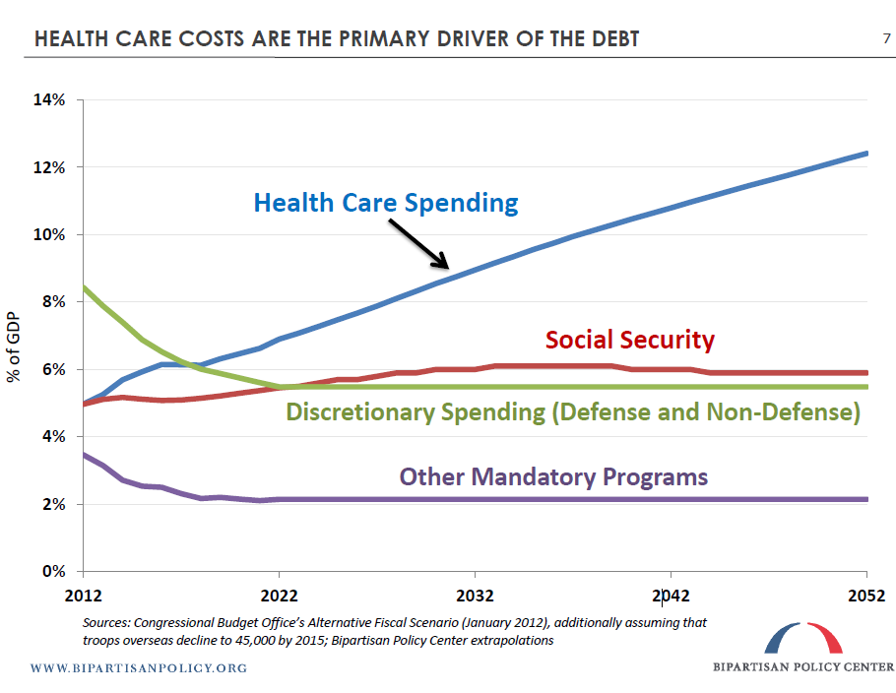

Slide 28
How we got here
House:
Total spending level of $967 billion
T-HUD bill passed out of committee, crashed and burned on floor, withdrawn
Senate
Total spending level of $1.058 trillion
T-HUD passed out of committee, floor vote blocked
$10 billion difference in T-HUD bill alone

