Slide 1
What’s Next for State-Aided Elderly Public Housing
CHAPA Breakfast Forum
October 8, 2013

Slide 2
Discussion Outline
Overview of Public Housing in MA
Ch.667 Program for Elderly & Special Needs Residents
Operations
Portfolio
Current Challenges
Strategies for Moving Forward
Notes:
About 83,000 units of public housing (not including any Section 8 or other rental voucher program).
Less than half, 37,441 are federally-subsidized by HUD.
The remaining 45,636 Units are State units (operating budget comes out of commonwealth’s annual budget and all capital projects (brick and mortar projects) are bond-funded). DHCD administers these funds.
Vast majority 66% of the state units are elderly units what we call ch.667 units.

Slide 3
Overview Public Housing in MA
240 Local Housing Authorities (LHAs)
37,441 Federal Units
45,635 State Units
Notes:
About 83,000 units of public housing (not including any Section 8 or other rental voucher program).
Less than half, 37,441 are federally-subsidized by HUD.
The remaining 45,636 Units are State units (operating budget comes out of commonwealth’s annual budget and all capital projects (brick and mortar projects) are bond-funded). DHCD administers these funds.
Vast majority 66% of the state units are elderly units what we call ch.667 units.

Slide 4
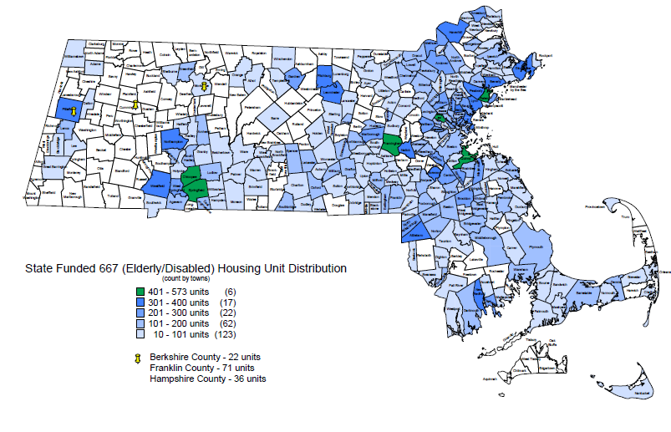
Locating Ch. 667 housing
Notes:
Our 30,253 units are spread across 229 housing authorities.
More than half of which have less than 100 units.
Communities with more than 400 units: Framingham, Arlington, Chicopee, Quincy, Salem, Springfield

Slide 5
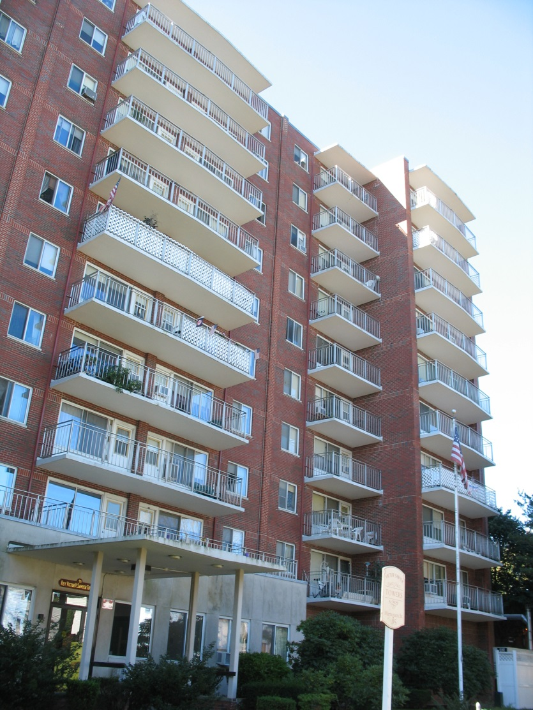
Ch. 667 Elderly Residents
Who is eligible?
Age 60 or higher
Earn less than 80% Area Median Income (AMI)
Who do we serve?
Estimate most residents in upper 70s
Vast majority earn less than 30% AMI
Most units occupied by one adult
Quincy
Notes:
In order to qualify must earn less than 80% AMI and be over 60.
Though we don’t keep perfect data, we know that vast majority of the residents earn below 30% AMI and are in their 70s.

Slide 6
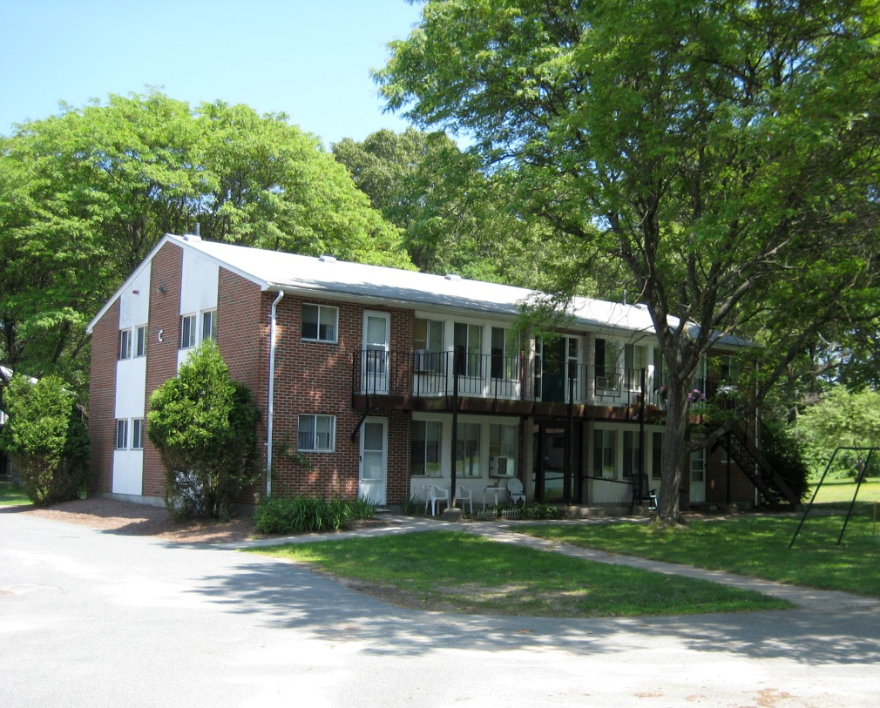
Ch. 667 Operations
Rent
Tenant pays 30% of income
Avg rent is $330/mo
Range is $250-450/mo
Demand for Units
Vacancy rate is 1.6% (484 units)
Waitlists vary across communities/markets
Abington
Notes:
Tenants pay 30% of income toward rent. Average rent is $330/ month
Translates to average yearly income of $13,200. Yearly income range of $10,000 to $18,000
In densely populated, strong market, could take several years to come in.
In weak market, cities that have endured population loss, could be no waitlist.

Slide 7
Ch. 667 Building Portfolio
Earliest construction was in 50s
Most units were built in 60s and 70s

Slide 8
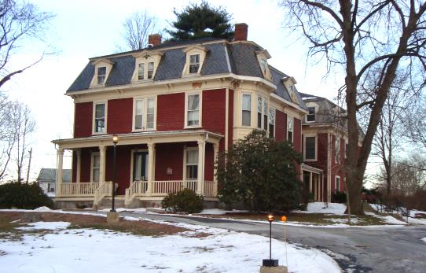
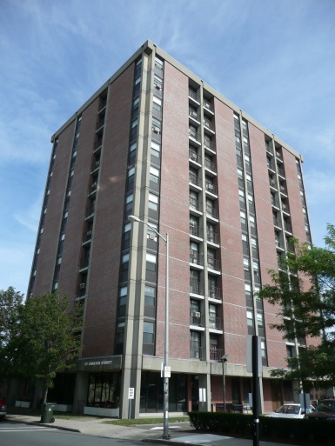
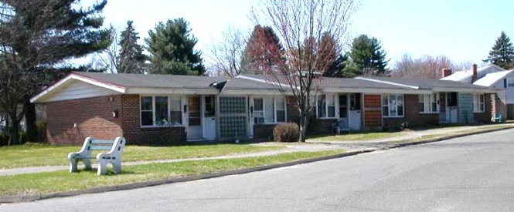
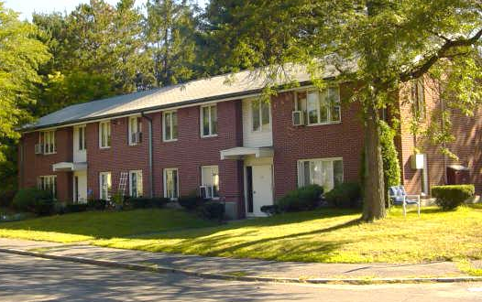
Ch. 667 Units By Building Type
Notes:
Four major typologies:
Most common by far are the two story flats – usually 8-12 units a building with shared stairway. The ones built in 60s are brick face later ones are clad in siding. Find in all parts of the state.
One story flats are also common – prevalent in the suburban areas. The oldest buildings in the portfolio are this type. Some (about 1250 units) suffer from being undersized (250-350 sf) and are therefore more challenging to rent. But generally good because no stairs
Multi-story/higher density buildings with elevators are more common in urban settings. Service delivery can benefit from economies of scale. Our only consistent challenge is that 89 of these buildings have only one elevator.

Slide 9
Current Challenges
Traditional
$1.2B+ backlog of deferred maintenance.
Need for more accessible units at many developments.
Need to expand access to supportive services.
Non-Traditional
Population ageing out of two-story walk ups.
Competing against the rest of the housing market.
Higher than average vacancy rates in congregate facilities.
Notes:
Traditional problems-
backlog of deferred maintenance in all State Public Housing due to variable sources of funding.
Expired & expiring building components: including elevators in our multi story buildings, fire protection, electrical, & emergency call systems
.
Overall lack of accessibility at many developments – both units and common spaces. We estimate need 490 units converted to meet goal of 5% across the entire 667 portfolio
Desire to expand services. 31 supportive senior housing sites, of which only 27 are in state PH: 4,076 of our 30,253 units are being served by the supportive housing program (Just 13% of our 667 units)
All the traditional problems could be addressed with more money.
Non traditional issues – these are not widespread across the whole portfolio (at least not yet). Here the solutions require more creativity flexibility. The ability to redesign, reprogram, or redevelop properties.
The two story walk up building type; as I said earlier, the two story walk up is the most common building type in the portfolio. As of now we are not seeing widespread chronic vacancy among the second floor units. These seem to get occupied within the regular turnover time of 60 days. However, there have been some complaints that these are harder to rent in some communities. Question is will this become a larger problem in the future. Or will the new generation of baby boomers that are ageing into eligibility increase the number of applicants for which this kind of apartment is viable?
In some post-industrial cities/towns, it is difficult to find tenants for elderly public housing due to the combined loss of population over the past 50 years and the availability of other more attractive affordable options in the private or federal developments. We’re looking for ways to make these more marketable – either by expanding service provision, changing layouts (combining two units into one).
Lastly, the congregate issue – As I said in last slide only 2% of our 670 of our 30,000 plus units are congregate units. However, 100 of these are vacant right now. They represent a disproportionate share of the total vacancies in our elderly portfolio. These need to be reprogrammed to other uses (emergency shelter, special needs housing) or reconfigured so as to provide private bathrooms – which is the biggest design flaw at our congregate sites. People want their own bathroom

Slide 10
Strategy A: Capital Programs
Formula Funding
Second Elevator
Accessible Unit
Health and Safety
Vacant Unit Reoccupancy
Capital Programs
Special Targeted Programs
HILAPP (Mixed Finance)
Traditional
$1.2B+ backlog of deferred maintenance.
Need for more accessible units at many developments.
Notes:
All the traditional problems could be addressed with more money.

Slide 11
Strategy B: Reprogram/Redevelop
Non-Traditional
Population ageing out of two-story walk ups.
Competing against the rest of the housing market.
Higher than average vacancy rates in congregate facilities.
Reprogram/Redevelop
Lower eligible age.
Combine units.
Pursue major redevelopment.
Reprogram buildings for different population.

Slide 12
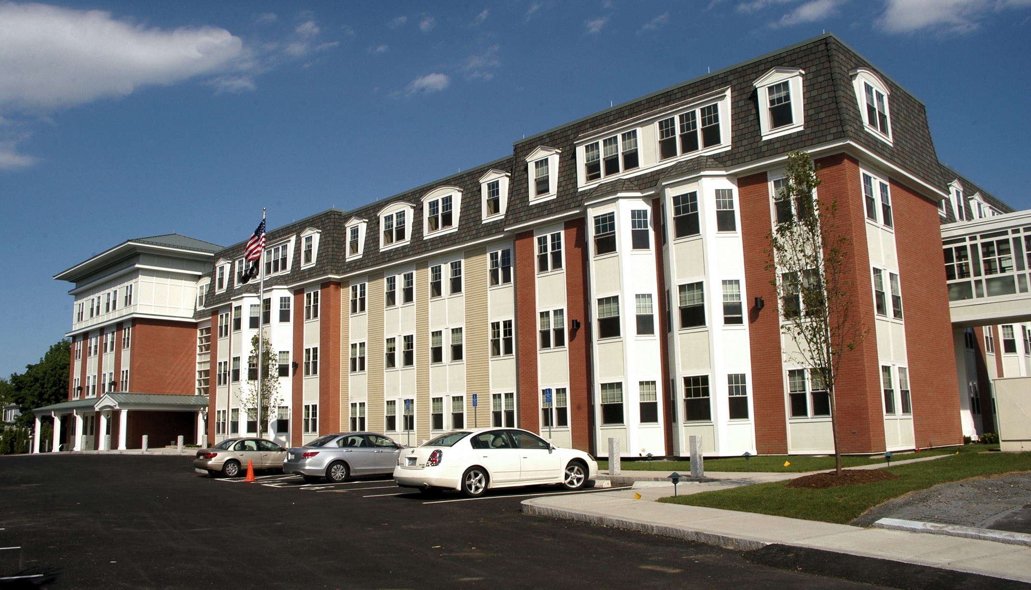
Case: Capen Court, Somerville
Demolition of functionally obsolete 64-unit development.
New construction of 95 affordable units with 64 reserved as public housing.
Resident access to services at adjacent Visiting Nurse assisted living community.
Notes:
About $17M project. TDC of $294,349/unit
Project based section 8 vouchers for 100% of units

Slide 13
Strategy C: Expand Services
Traditional
Need to expand access to supportive services.
Solution
Increase funding for Supporting Housing in state budget.
Use Social Innovation Financing to demonstrate how investing in these services yields quantifiable financial and social benefits
Notes:
In this fiscal climate, budget line item increases are hard to secure.
Looking to other sources to finance our expansion. Social Innovation Financing is a promising tool.
DHCD partnering with Administration and Finance and Mass Health already for a SIF program to fight chronic homelessness
Secretariat is very supportive of this direction and would like to work with the same partners and EOEA plus others on an Ageing In Place SIF

Slide 14
Social Innovation Financing (SIF)
Given:
State of MA pays 50% of all Medicaid expenses.
Most ch. 667 residents are Medicaid eligible.
Question:
Can we pilot a pay-for-success program that demonstrates how an upfront investment in elder supportive services can defer moves to nursing homes and reduce overall medical expenditures?
Medicaid expenditures
Supportive services
Notes:
Knowing that state pays 50% of all Medicaid expenses and that most of our residents are medicaid eligible,
Could we pilot pay-for success ageing in place model, where service providers would test their effectiveness at reducing health care costs among our residents – big savings from deferring moves to nursing homes, but others routinely – hospitalizations, visits to nursing homes, etc.
Our sketchy plan is to pilot 10 new supportive sites and study the and other sites over three years.
Three housing models to compare outcomes:
Regular 667 with no extra services
Existing 667 sites with Supportive Housing Initiative (selected from the 27)
New set of 10 pilot sites where we’ll apply a slightly enhanced service package – includes more physical & social activities
What is the effect on health and on subsidy?

Slide 15
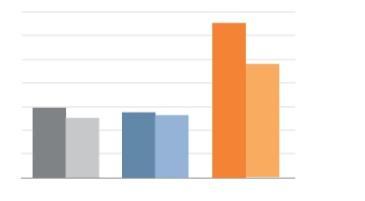
Social Innovation Financing (SIF)
Unit turnover data from 2006-2013 shows that a lower percentage of residents move to nursing homes from supportive housing initiative (SHI) sites than from regular ch. 667 sites.
Can we understand and replicate the “Chelmsford effect”?
Percent of Seniors Exiting to Nursing Homes Annually
7%
6%
5%
4%
3%
2%
1%
-27%
-15%
-5%
No SHI
SHI
No SHI
SHI
No SHI
SHI
MA
Lynn
Chelmsford
Notes:
Already have some data, though imperfect, that suggests we are onto something.
Turnover rates – nursing homes.
In spring, Harvard students did a financial model for us that forecasted federal and state savings over a 10 year period assuming the Chelmsford effect. However after sharing this model with stakeholders, we realized that it omitted some key variables in the true Medicaid subsidy that goes to public housing residents.
Nevertheless we have some logical data to back up our desire to test the hypothesis.

Slide 16
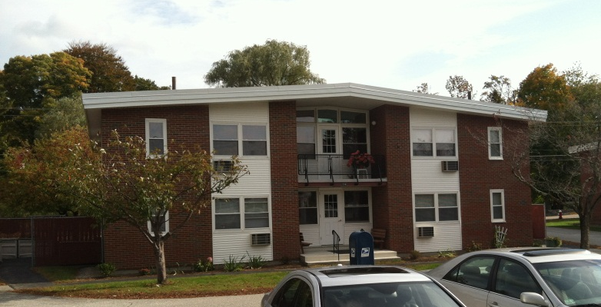
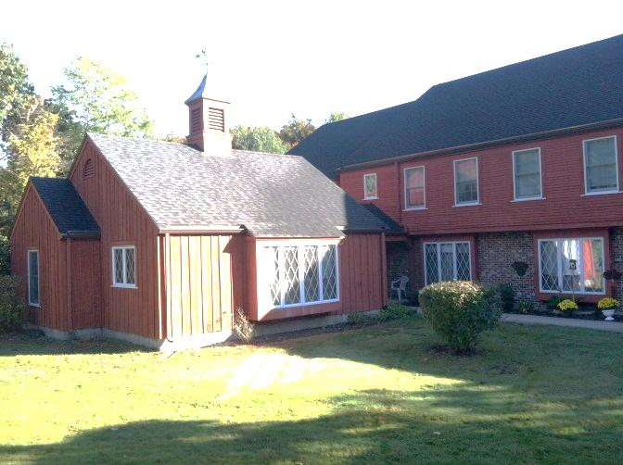
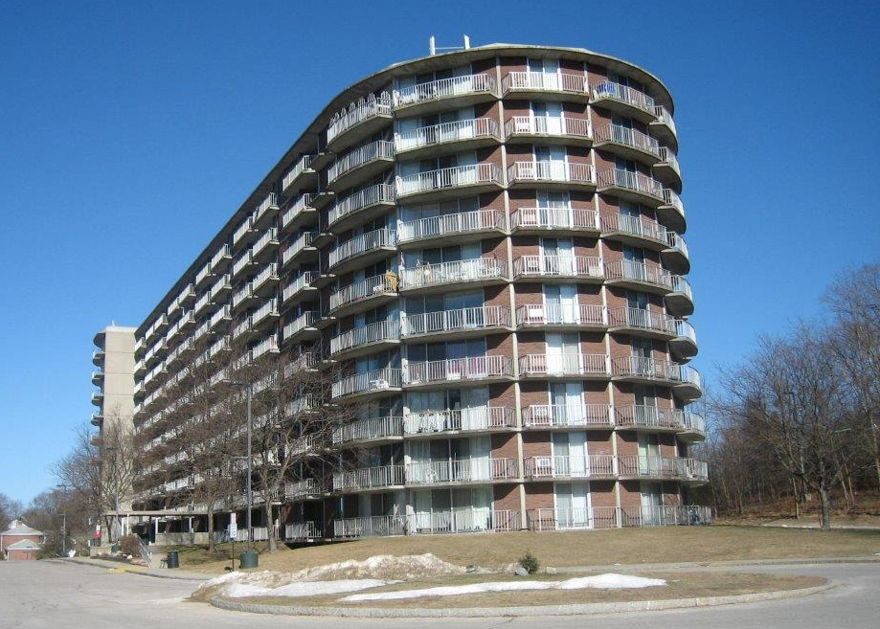
Thank you!
Contact: amy.stitely@state.ma.us
Westborough
Lynnfield
Brockton
Oxford

