Slide 1
DRAFT Budget Requests FY2024
Line-Item | Program | DRAFT FY2024 Requests | FY2023 Requests | FY2023 Budget
7004-9024 | Mass. Rental Voucher Program | $250,000,000 | $200,000,000 | $154,000,000†
7004-9030 | Alternative Housing Voucher Program | $26,000,000 | $19,000,000 | $13,685,355‡
7004-9316 | Residential Assistance for Families in Transition | $250,000,000 | $250,000,000 | $150,000,000*
7004-9005 | Public Housing Operating | $184,000,000 | $92,000,000 | $92,000,000
7004-3036 | Housing Consumer Education Centers | $10,185,000 | $8,200,000 | $9,700,000
7004-9007 | Public Housing Reform | $7,700,000 | $1,000,000 | $1,000,000
7004-0104 | Home & Healthy for Good | $8,390,000 | $6,390,000 | $6,390,000
7004-0108 | HomeBASE | $60,000,000 | $59,911,201 | $59,411,201
7006-0011 | Foreclosure & Housing Counseling | $3,050,000 | $3,050,000 | $3,050,000
NEW | Access to Counsel Program | $7,000,000 | - | -
7004-3045 | Tenancy Preservation Program | $1,800,000 | $1,800,000 | $1,800,000
4120-4001 | MassAccess Registry | $150,000 | $150,000 | $150,000
4000-0007 | Unaccompanied Homeless Youth | $12,000,000 | $10,000,000 | $9,500,000
7004-0106 | New Lease for Homeless Families | $250,000 | $250,000 | $250,000
† Includes language to carryover unspent funds from FY22 bringing total FY23 funding for MRVP to an estimated $175 million
‡ Includes language to carryover unspent funds from FY22 bringing total FY23 funding for AHVP to an estimated $19.2 million
* An estimated $60 million in unspent RAFT funds from FY22 will carryover into FY23 bringing total FY23 funding for RAFT to an estimated $210 million

Slide 2
MRVP & AHVP in FY2023
 | MRVP | AHVP
FY2023 projected spending | $154,275,496 | $10,976,642
Estimated FY2023 surplus | $19,000,000 | $8,200,000
Mobile vouchers leased | 5,238 | 695
Mobile vouchers allocated | 6,353 | 1,150
Project-Based vouchers leased | 4,229 | n/a*
Project-Based vouchers allocated | 6,322 | n/a
Total leased vouchers (mobile & project-based) | 9,467 | n/a
Total allocated vouchers (mobile & project-based) | 12,675 | n/a
Monthly subsidy cost per voucher | $1,267 | $1,176
*AHVP does not have project-based vouchers
All data from the Department of Housing and Community Development as of January 2023
No new mobile MRVP vouchers issued in FY2023; 200 project-based MRVPs issued in FY2023
MRVP to be integrated into CHAMP – expected by September 2023 – eligibility screening will also become centralized
MRVP monthly cost went up from $1,168 in July 2022 to $1,267 in January 2023 – reflects program changes made, including moving to a rent standard, including utilities, and lowering tenant rent share to 30% of income (for comparison, Section 8 per month cost is about $1,250)

Slide 3
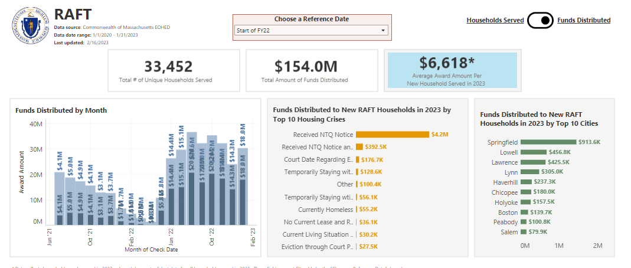
RAFT Expenditure in FY2023

